Slide 1

CSE3251
Computer Networks
Dr. Asif Zaman
Professor, CSE, RU

Slide 2
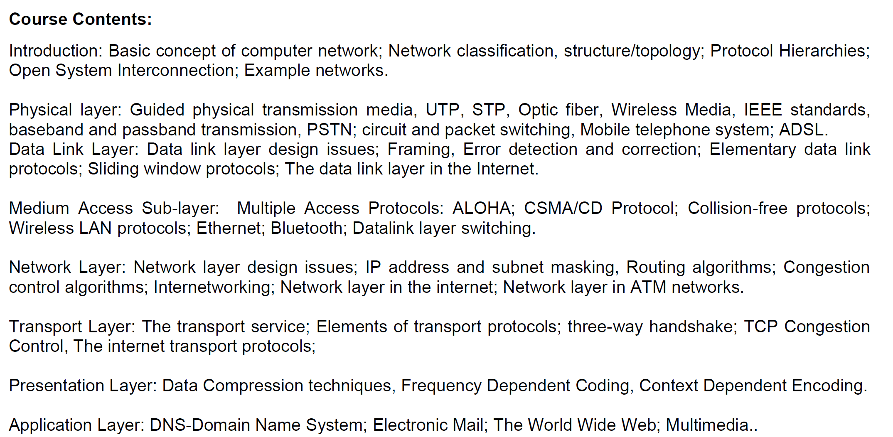

Slide 3
Medium Access Sublayer

Slide 4
Ethernet
Many of the designs for PAN, LAN, and MAN… standardized under the name of IEEE 802.
A few have survived but many have not.
The most important of the survivors are:
802.3 (Ethernet) and
802.11 (wireless LAN)
Bluetooth (wireless PAN) is widely deployed but has now
been standardized outside of 802.15.
With 802.16 (wireless MAN)

Slide 5
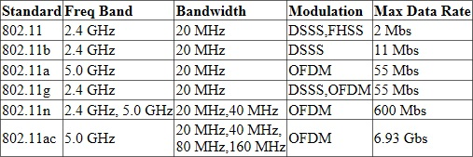
FHSS (Frequency-hopping Spread Spectrum)
DSSS (Direct-sequence Spread Spectrum)
OFDM (Orthogonal Frequency Division Multiple-Access)
The 802.11 standard, approved in 1997, applies to wireless LANs with a 1 or 2 Mbps transmission rate in the 2.4 GHz band.
Sometimes the term 802.11 is used to refer to the 802.11x family of specifications.

Slide 6
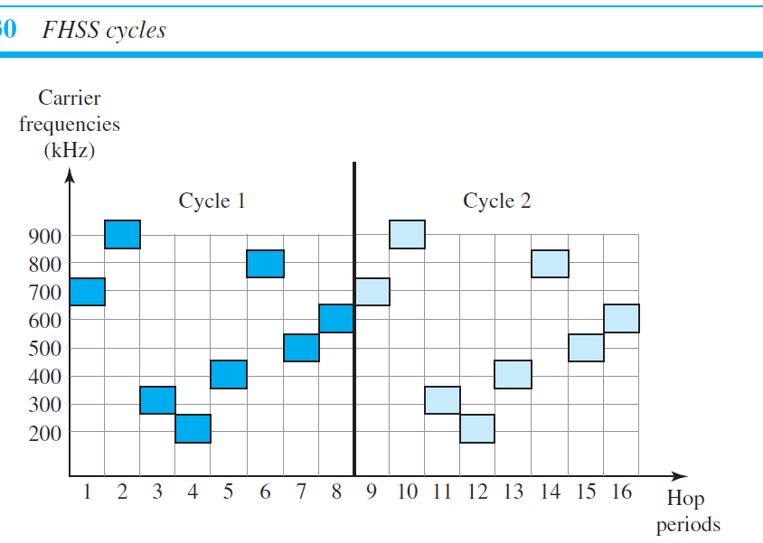
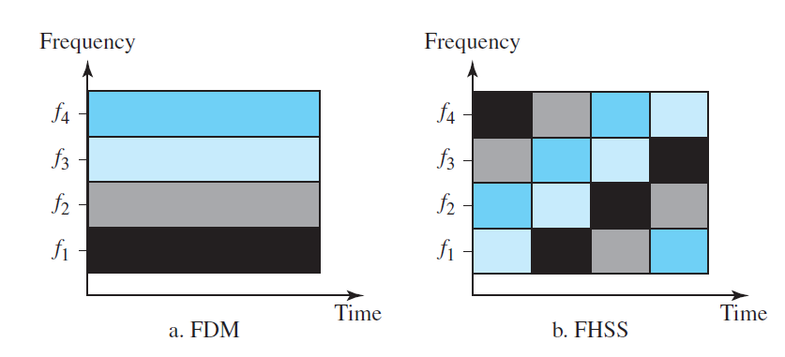

Slide 7
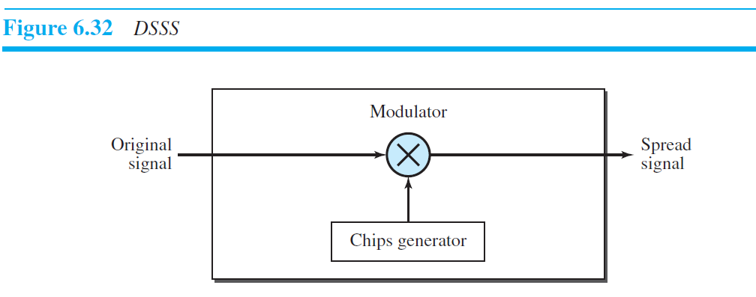
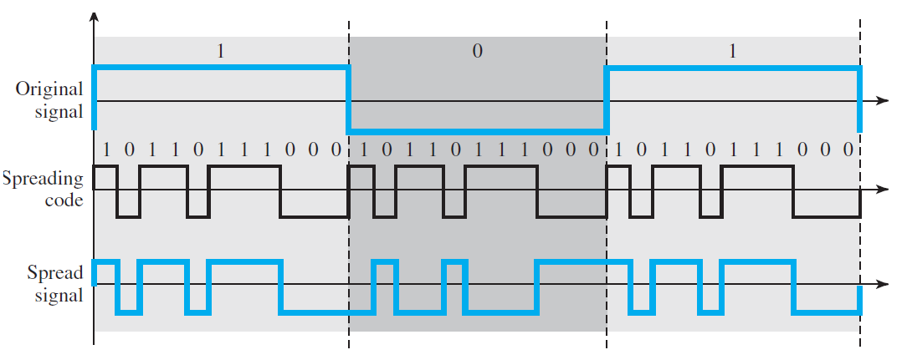

Slide 8
802.11b
In September of 1999,
It supports a maximum bandwidth up to 11Mbps in the 2.4GHz S-Band Industrial, Scientific, and Medical (ISM) frequency range.
Being an unregulated frequency, 802.11b device can suffer from interference from other wireless users, cordless phones, microwave ovens and other devices using the same 2.4 GHz band.

Slide 9
802.11a
About the same time 802.11b was created, 802.11a was created.
802.11a supports a maximum bandwidth up to 55Mbps in the 5GHz band.
An advantage of 802.11a is that it operates at a radio frequency that's less clogged by competing signals from other wireless users, cordless phones and microwave ovens.
But 802.11a was not popular due to the more expensive cost of 5GHz components and not being compatible with 802.11b.

Slide 10
802.11g
In June 2003, 802.11g was released to provide maximum bandwidth up to 55Mbps in the 2.4GHz band.
802.11g is backward compatible with 802.11b because they both use the same 2.4GHz radio frequency.
However 802.11g again suffers from the same interference as 802.11b in the crowded 2.4 GHz range, But 802.11g provides better security features, such as WiFi Protected Access (WAP) and WPA2 authentication with pre-shared key or RADIUS server.

Slide 11
802.11n
In October 2009 the IEEE approved 802.11n wireless communication standard to provide a maximum bandwidth up to 300Mbps. 802.11n can operate in the 2.4GHz or 5GHz band, and is backward compatible with 802.11a (5GHz band), 802.11b (2.4GHz band) and 802.11g (2.4GHz band) devices.
The 802.11n standard supports MIMO (Multiple Input, Multiple Output) antennas. 802.11n operates on both the 2.4 GHz and the 5 GHz bands. Support for 5 GHz bands is optional. It operates at a maximum net data rate from 54 Mbps to 600 Mbps.

Slide 12
802.11ac
IEEE 802.11ac delivers speeds ranging from 433 Mbps up to several gigabits per second. It works exclusively in the 5GHz band. 802.11ac operates up to eight MIMO (Multiple Input, Multiple Output) antennas. It uses beamforming technology which sends the signal directly to client devices.

Slide 13
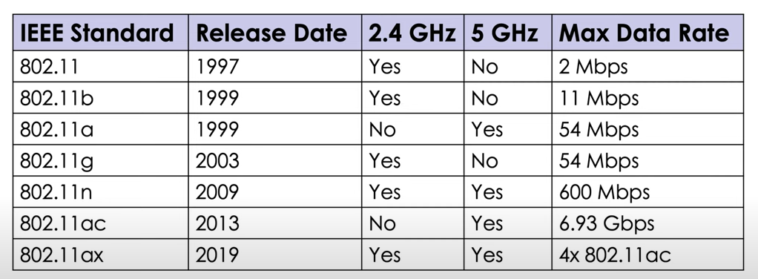

Slide 14
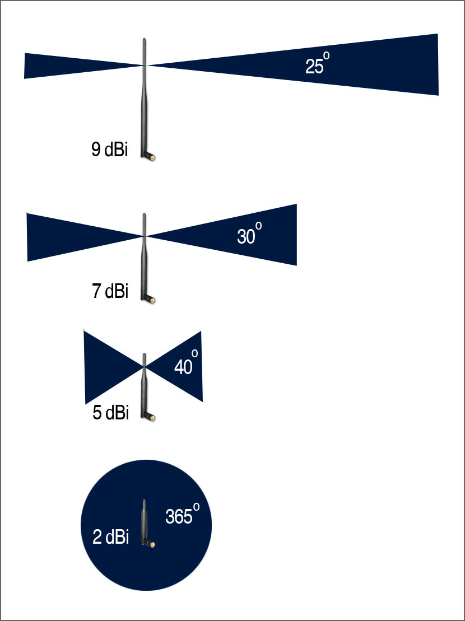

Slide 15
Ethernet
Two kinds of Ethernet exist:
Classic Ethernet
Switch Ethernet
Classic Ethernet: ran at rates from 3 to 10 Mbps.
Switched Ethernet: runs at 100, 1000, and 10,000 Mbps, in forms called
fast Ethernet,
gigabit Ethernet, and
10 gigabit Ethernet

Slide 16
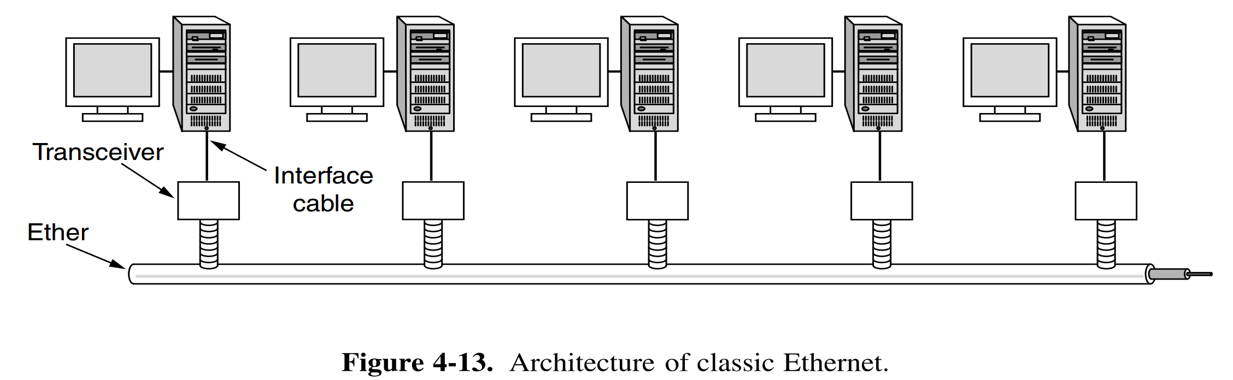
Ethernet
Classic Ethernet:
Classic Ethernet snaked around the building as a single long cable to which all the computers were attached.

Slide 17
Ethernet
Classic Ethernet:
Thick Ethernet
The first variety, popularly called thick Ethernet, resembled a yellow garden hose, with markings every 2.5 meters to show where to attach computers.
500m per segment
100 machine /segment
Thin Ethernet
which bent more easily and made connections using industry-standard BNC connectors
185m per segment
30 machine / segment

Slide 18
Ethernet
Each version of Ethernet has a maximum cable length per segment (i.e., unamplified length) over which the signal will propagate.
To allow larger networks, multiple cables can be connected by repeaters.
A repeater is a physical layer device that receives, amplifies (i.e., regenerates), and retransmits signals in both directions.
An Ethernet could contain multiple cable segments and multiple repeaters, but no two transceivers could be more than 2.5 km apart and no path between any two transceivers could traverse more than four repeaters

Slide 19
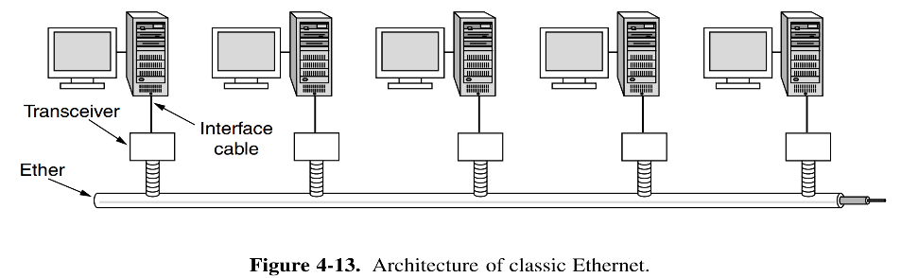
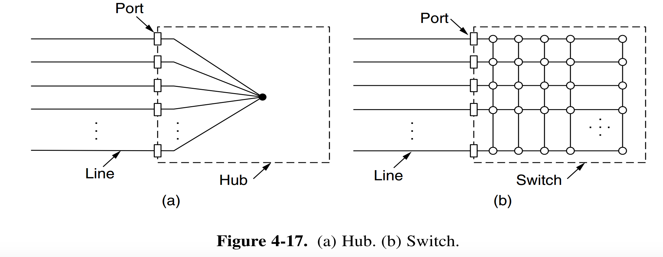
Ethernet
Collision Doman
Hub vs Switch
Working procedure of switch

Slide 20
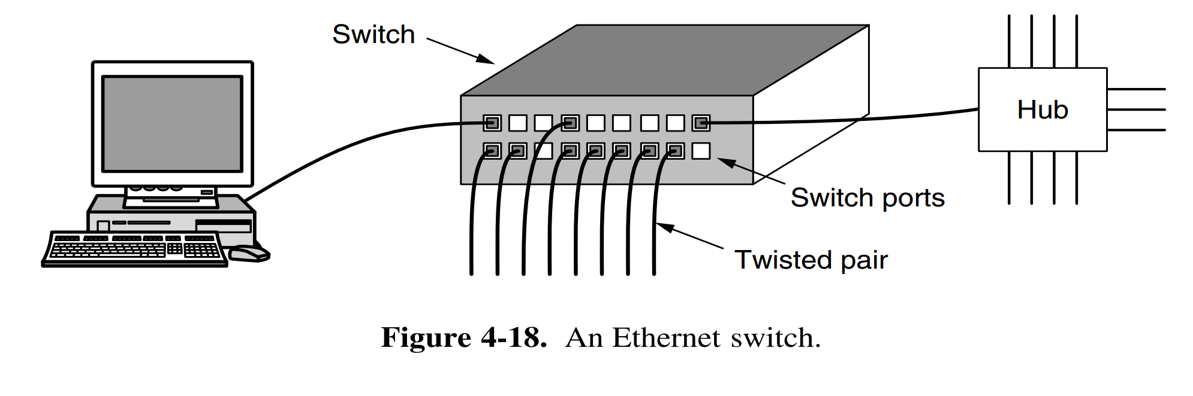
Ethernet

Slide 21
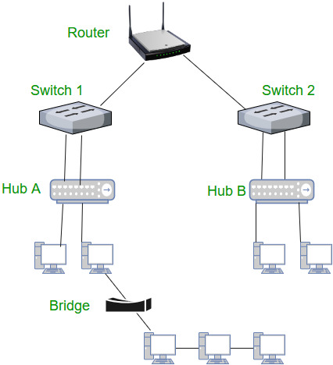
Hub vs Switch vs Router

